Slide 1

Application of predicate calculus
Group 4

Slide 2

Group Members
22BCG10111 | UTTAM KUMAR SINGH | uttamkumarsingh2022@vitbhopal.ac.in
22BCG10130 | VARCHASVA KHARE | varchasvakhare2022@vitbhopal.ac.in
22BCG10154 | DEVANSH VIJAY KHANDARE | devanshvijaykhandare2022@vitbhopal.ac.in
22BCG10163 | ADITYA SARASWATI | adityasaraswati2022@vitbhopal.ac.in
22BCG10164 | SHIVANI GUPTA | shivanigupta2022@vitbhopal.ac.in
22BCY10013 | SAJAL SETH | sajalseth2022@vitbhopal.ac.in
22BCY10017 | DHRUV LEKHI | dhruvlekhi2022@vitbhopal.ac.in
22BCY10024 | PRIYANSHU TIWARI | priyanshutiwari2022@vitbhopal.ac.in
22BCY10026 | ADITYA RAJEEV PATIL | adityarajeevpatil2022@vitbhopal.ac.in
22BCY10058 | AYUSH PADEKAR | ayushpadekar2022@vitbhopal.ac.in
22BCY10083 | VAYUNA SINGH | vayunasingh2022@vitbhopal.ac.in
22BCY10085 | REKHANSH RAJE DESHMUKH | rekhanshrajedeshmukh2022@vitbhopal.ac.in
22BCY10099 | GAURI PANDEY | gauripandey2022@vitbhopal.ac.in
22BCY10145 | PARTH SINHA | parthsinha2022@vitbhopal.ac.in
22BCY10152 | AKSHAT VANJANI | akshatvanjani2022@vitbhopal.ac.in

Slide 3
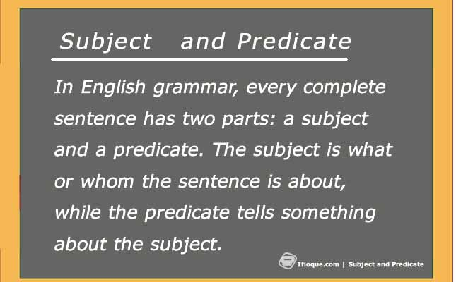
Introduction to Predicate calculus
Predicate calculus, also known as first-order logic or first-order predicate logic, is an extension of propositional logic that introduces variables, quantifiers, and predicates to represent and reason about more complex statements and relationships.
In propositional logic, statements are represented using simple propositions or variables and are connected using logical connectives
(AND, OR , NOT). However, propositional logic cannot express relationships or properties involving objects or individuals in a structured way.

Slide 4
Predicate calculus extends this by introducing the following elements:
Variables: Predicate calculus allows the use of variables to represent objects or individuals in the domain of discourse. This enables us to make statements that refer to any object rather than specific ones.
Predicates: Predicates are functions that take one or more variables as arguments and return a truth value (True or False). Predicates are used to describe properties, relationships, or conditions involving objects in the domain.
Quantifiers: Predicate calculus introduces quantifiers, such as the universal quantifier (∀) and the existential quantifier (∃). These quantifiers allow us to make statements about all objects in the domain (universal quantification) or at least one object in the domain (existential quantification).

Slide 5
By incorporating variables, predicates, and quantifiers, predicate calculus enables the expression of complex statements like "For all x, if x is a human, then x is mortal" or "There exists an x such that x is a prime number." This added expressiveness makes predicate calculus a powerful tool for formalizing and reasoning about relationships, properties, and conditions in various domains, including mathematics, philosophy, computer science, and artificial intelligence. It serves as a foundation for more advanced logical systems and knowledge representation languages.

Slide 6
Statements and its examples
Statements in the context of predicate calculus are declarative sentences that can be either true or false. These statements are typically constructed using predicates, variables, and quantifiers. 1.Simple Predicate Statement:
Predicate: "P(x)" representing "x is a student."
Statement: "John is a student," where "John" is a specific value for the variable "x."
Truth Value: True if John is indeed a student, False if not.
2.Universal Quantification:
Statement: "For all x, P(x)" meaning "Every person is a student."
Here, the statement asserts that the predicate "P(x)" holds true for every possible value of "x."
3.Existential Quantification:
Statement: "There exists an x such that P(x)" meaning "There is at least one student."
The statement is true if there is at least one individual for which "P(x)" is true.
4.Negation:
Predicate: "Q(x)" representing "x is not a professor."
Statement: "It is not the case that Q(x)," which negates the predicate.
Truth Value: True if the individual represented by "x" is not a professor.

Slide 7
5.Complex Statement with Connectives:
Predicates: "R(x)" representing "x is an engineer" and "S(x)" representing "x is a programmer."
Statement: "For all x, (R(x) → S(x))" meaning "Every engineer is a programmer."
The implication (→) connects the predicates, stating that if someone is an engineer, they are also a programmer.

Slide 8
Notation used in predicate calculus
In predicate calculus, several notations are used to represent different elements of statements. Here's a brief explanation:
Predicates: Predicates are represented using symbols or letters, often followed by one or more variables within parentheses. For example, "P(x)" might represent the predicate "x is a student."
Variables: Variables are typically represented using lowercase letters, such as "x," "y," or "z." They stand for unspecified individuals or objects in the domain of discourse.
Quantifiers: Quantifiers indicate the scope of a statement. Common quantifiers include:
Universal Quantifier (∀): Represents "for all" or "for every." For example, "∀x" signifies "for all x."
Existential Quantifier (∃): Represents "there exists" or "there is." For example, "∃x" signifies "there exists an x."
Connectives: Connectives like AND (∧), OR (∨), and NOT (¬) are used to combine and manipulate statements, just like in propositional logic.
Brackets and Parentheses: Parentheses are used to group elements of a statement and clarify the order of operations. For instance, "(P(x) ∧ Q(y))" indicates that "P(x)" and "Q(y)" are combined using the AND operator.
Implication (→): The implication operator is used to represent conditional statements. For example, "P(x) → Q(x)" means "If P(x) is true, then Q(x) is true."
Equality (=): The equality symbol is used to express that two expressions or variables are equal. For example, "x = y" means that "x" and "y" have the same value.

Slide 9
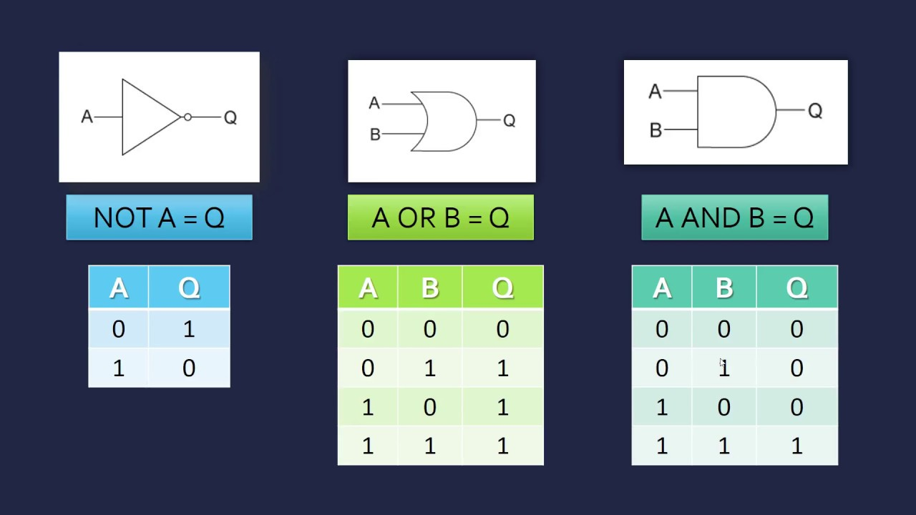
Connectives
In predicate calculus, the logical connectives (AND, OR, NOT) are used to combine or modify statements that involve predicates, variables, and quantifiers. These connectives allow you to form more complex statements by specifying the relationships between different predicates or modifying the truth values of existing statements. Here's an explanation of how these connectives work, along with examples:

Slide 10
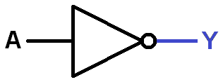
NOT
NOT (¬): The NOT operator represents negation, and it is used to reverse the truth value of a statement. If a statement is true, its negation is false, and vice versa.
Example: Let's consider the predicate:
T(x): "x is not a scientist."
The negation of T(x) is represented as ¬T(x) and means "x is a scientist." So, ¬T(x) is true if and only if the individual x is a scientist.

Slide 11
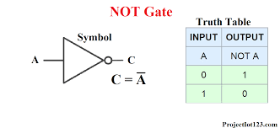
NOT

Slide 12
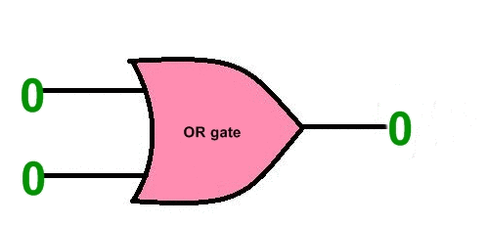
OR
. OR (∨): The OR operator represents logical disjunction, meaning that a compound statement using ∨ is true if at least one of its component statements is true.
Example: Consider two predicates:
R(x): "x is a teacher."
S(x): "x is an author.“
We can create a compound statement using ∨: "R(x) ∨ S(x)," which would mean "x is a teacher or x is an author." This statement is true if either predicate R(x) or S(x) is true for the individual x, or if both are true

Slide 13
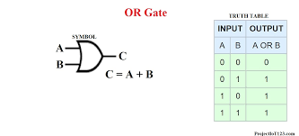
OR

Slide 14
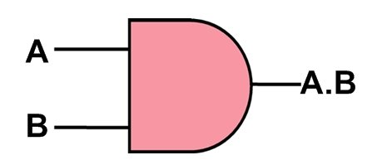
AND
AND (∧): The AND operator represents logical conjunction, meaning that a compound statement using ∧ is true only if both of its component statements are true.
Example: Let's say we have two predicates:
P(x): "x is a student."
Q(x): "x is diligent.“
We can create a compound statement using ∧: "P(x) ∧ Q(x)," which would mean "x is a student and x is diligent." This statement is true if and only if both predicates P(x) and Q(x) are true for the same individual x.

Slide 15
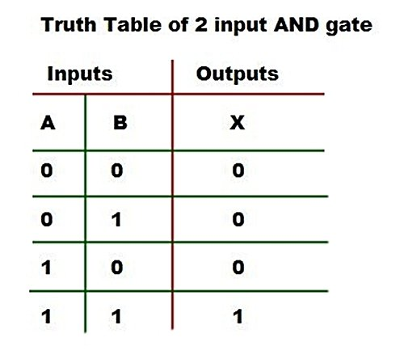
AND

Slide 16
Complex Examples: You can also use these connectives to create more complex statements. For instance:
"(P(x) ∧ Q(x)) ∨ (R(x) ∧ S(x))" means "Either x is a student and diligent or x is a teacher and an author."
"¬(P(x) ∧ Q(x))" means "It is not the case that x is both a student and diligent."
These examples illustrate how the logical connectives in predicate calculus help build compound statements that express various conditions, relationships, and combinations of predicates involving variables and quantifiers. The use of connectives allows for precise and flexible representation of information and logical reasoning.

Slide 17


Slide 18
Tautology
Tautology: A tautology is a statement that is always true, regardless of the specific values assigned to the variables and predicates within the statement. In other words, it has a truth value of true under all possible interpretations.
Example: Consider the statement
"∀x (P(x) ∨ ¬P(x))." This statement asserts that for any value of x, either P(x) is true or its negation ¬P(x) is true. Since it covers all possible cases (true and false), it is a tautology because it is always true.

Slide 19
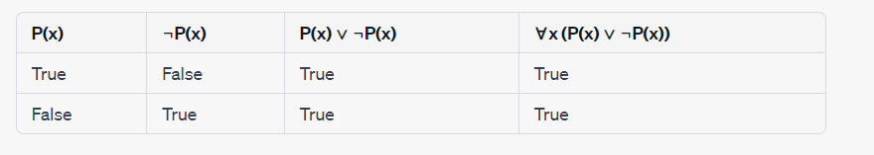
Truth table for ∀x (P(x) ∨ ¬P(x))
As in the last column all values comes out to be TRUE, so it is Tautology

Slide 20
Contradiction
Contradiction: A contradiction is a statement that is always false, regardless of the specific values assigned to the variables and predicates within the statement. It has a truth value of false under all possible interpretations.
Example: The statement "∃x (P(x) ∧ ¬P(x))" asserts that there exists an x for which both P(x) and ¬P(x) are true simultaneously. This is contradictory because it's impossible for something to be both true and false at the same time, making the statement always false.

Slide 21
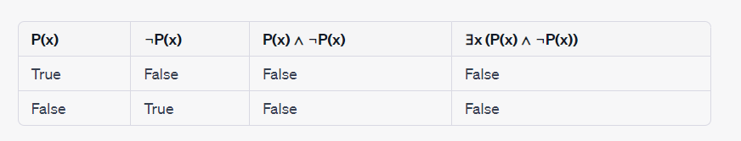
Truth table for "∃x (P(x) ∧ ¬P(x))"
As in the last column all values comes out to be FALSE , so it is Contradiction

Slide 22
Contingency
Contingency: A contingency is a statement that can be either true or false, depending on the specific values assigned to the variables and predicates within the statement. It is neither a tautology nor a contradiction.
Example: Consider the statement "∃x (P(x) ∨ Q(x))." This statement asserts that there exists an x for which either P(x) or Q(x) is true. Depending on the specific predicates P(x) and Q(x) and the values assigned to x, this statement can be true or false. It is contingent because it is not always true or always false.

Slide 23
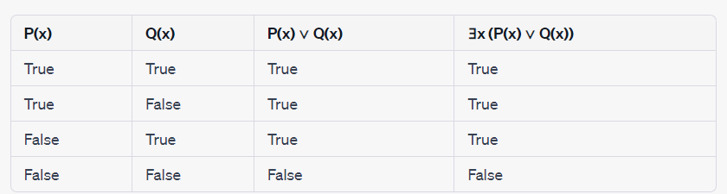
Truth table for ∃x (P(x) ∨ Q(x))
As the value comes out to be mixed values of TRUE and FALSE , so it is contingency

Slide 24
Logical Equivalence
Logical equivalence in predicate calculus refers to the relationship between two statements, where both statements always have the same truth value under all possible interpretations. In other words, if two statements are logically equivalent, they are either both true or both false in every possible scenario. In predicate calculus, you can establish logical equivalence between two statements by demonstrating that they have the same truth conditions.

Slide 25
Example of Logical Equivalence:
Consider the following two statements:
Statement A: ∀x (P(x) ∧ Q(x))
Statement B: ∀x P(x) ∧ ∀x Q(x)
Statement A asserts that for all values of x, both P(x) and Q(x) are true simultaneously. Statement B, on the other hand, separately asserts that for all values of x, P(x) is true and also that for all values of x, Q(x) is true.
These two statements are logically equivalent because they have the same truth conditions. If Statement A is true, it means that for every x, both P(x) and Q(x) are true, which implies that both ∀x P(x) and ∀x Q(x) are true as well (and vice versa).

Slide 26
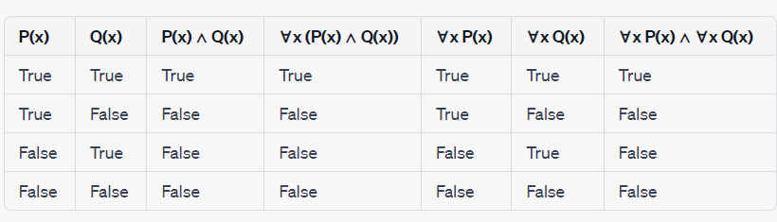
Truth table for Statement A: ∀x (P(x) ∧ Q(x)) Statement B:∀x P(x) ∧ ∀x Q(x)

Slide 27
Implication in Predicate Calculus:
Implication in predicate calculus represents a conditional relationship between two statements. In predicate calculus, the implication operator (→) is used to express that one statement (the antecedent) implies another statement (the consequent). The implication is true unless the antecedent is true, and the consequent is false.

Slide 28
Example of Implication:
Consider the following two statements:
Statement C: ∀x (P(x) → Q(x))
Statement D: ¬∃x (P(x) ∧ ¬Q(x))
Statement C asserts that for all values of x, if P(x) is true, then Q(x) is true. This means that whenever P(x) is true, it implies that Q(x) is also true.
Statement D, on the other hand, asserts the negation of the existence of any x for which P(x) is true and ¬Q(x) is true. In other words, it states that there is no x for which P(x) is true while Q(x) is false.
These two statements are not logically equivalent, but Statement D implies Statement C. If Statement D is true (i.e., there is no x for which P(x) is true while Q(x) is false), it implies that Statement C must also be true, as there are no counterexamples to the implication "P(x) → Q(x)." However, the reverse is not necessarily true; Statement C being true does not necessarily imply Statement D.

Slide 29
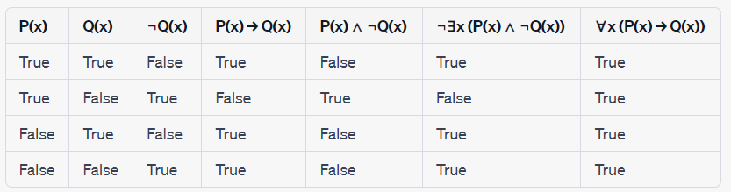
Truth table for Statement C: ∀x (P(x) → Q(x)) Statement D: ¬∃x (P(x) ∧ ¬Q(x))

Slide 30
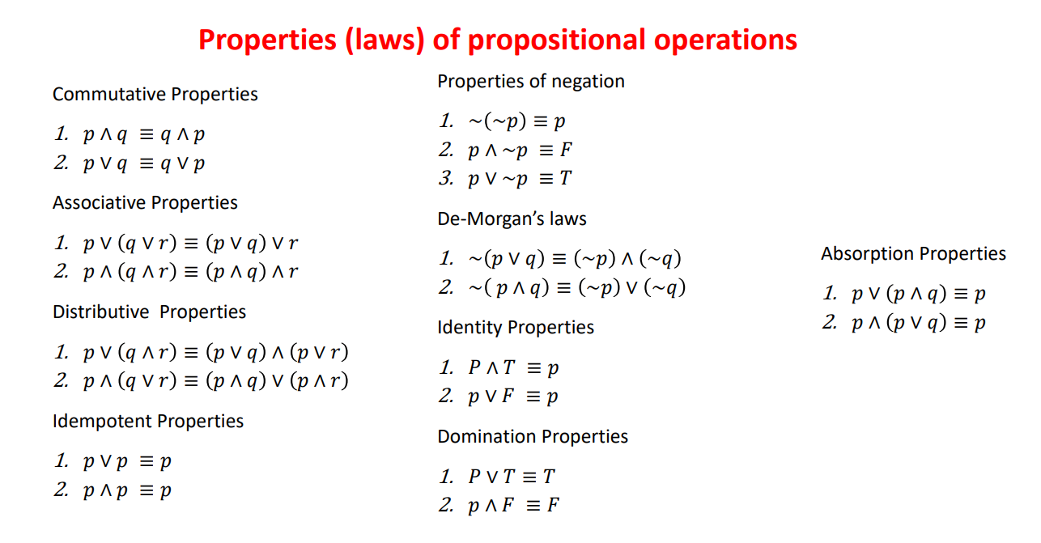
Laws of Propositional Operation

Slide 31
Predicate & Quantifier
Predicates and quantifiers are fundamental concepts in predicate calculus, which is an extension of propositional logic used to express more complex statements and relationships involving variables and objects.
Predicates: Predicates are expressions or functions that involve variables and describe properties, relationships, or conditions that can be true or false. They represent statements that can be evaluated as either true or false depending on the values assigned to the variables.
Quantifiers: Quantifiers are used to specify the scope of a predicate over a set of objects or elements in a domain. There are two main quantifiers in predicate calculus:
Universal Quantifier (∀): Denoted as "∀," it represents "for all" or "for every." It asserts that a predicate is true for every element in the specified domain.
Existential Quantifier (∃): Denoted as "∃," it represents "there exists." It asserts that there is at least one element in the specified domain for which a predicate is true.

Slide 32
Examples to Illustrate Predicates and Quantifiers:
Predicates without Quantifiers:
Predicate: P(x) represents "x is a prime number."
In this case, the predicate P(x) represents the property of being a prime number. It can be evaluated for different values of x to determine whether they are prime numbers or not.
Universal Quantifier (∀):
Statement: ∀x P(x) asserts "All natural numbers are prime."
This statement uses the universal quantifier to claim that for every natural number x, the predicate P(x) (x is a prime number) is true. However, this statement is not true because not all natural numbers are prime.

Slide 33
Existential Quantifier (∃):
Statement: ∃x P(x) asserts "There exists a prime number."
This statement uses the existential quantifier to claim that there is at least one natural number x for which the predicate P(x) (x is a prime number) is true. This statement is true because there are indeed prime numbers in the set of natural numbers.

Slide 34
Nested Quantifier
Nested quantifiers occur in statements when one or more quantifiers are placed within the scope of another quantifier. This means that the scope of one quantifier is determined by another quantifier, and this nesting can go to multiple levels. Nested quantifiers are used to express complex relationships or conditions involving multiple variables and quantifications.

Slide 35
Here's a brief explanation of the concept of nested quantifiers and some examples:
1. Existential Quantifier (∃) within Universal Quantifier (∀):
Example: ∀x ∃y (x + y = 0)
Interpretation: For every value of x, there exists a value of y such that the sum of x and y is equal to 0. In other words, for each x, there is at least one y that makes the equation true.
2. Universal Quantifier (∀) within Existential Quantifier (∃):
Example: ∃x ∀y (x < y)
Interpretation: There exists a value x such that for all values of y, x is less than y. This statement asserts the existence of a minimum element in the set of y values.
3. Multiple Nested Quantifiers:
Example: ∀x ∃y ∃z (x + y + z = 10)
Interpretation: For every value of x, there exist values of y and z such that their sum is equal to 10. This statement describes a more complex relationship involving three variables.
4. Multiple Nested Quantifiers with Different Quantifiers:
Example: ∃x ∀y ∃z (x * y = z)
Interpretation: There exists a value x such that for all values of y, there exists a value z such that x multiplied by y equals z. This statement combines both existential and universal quantifiers to express a relationship involving multiplication.

Slide 36
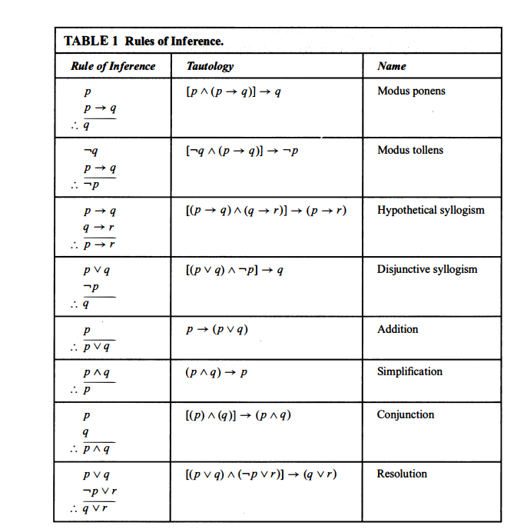
Rules of Inference

Slide 37
EXAMPLE 1: Suppose that the conditional statement "If it snows today, then we will go skiing" and its hypothesis, "It is snowing today," are true. Then, by modus ponens, it follows that the conclusion of the conditional statement, "We will go skiing," is true. The example you provided illustrates a valid application of modus ponens, which is a valid deductive argument form. Here's the breakdown of your example:
1. Conditional Statement: "If it snows today, then we will go skiing."
2. Hypothesis: "It is snowing today."
Using modus ponens, we can draw the following valid conclusion:
3. Conclusion: "We will go skiing."
Modus ponens can be formally represented as:
- If P → Q (If P implies Q).
- P (P is true).
- Therefore, Q (Q is also true).
In your example, "P" corresponds to "It is snowing today," "Q" corresponds to "We will go skiing," and the conditional statement "If it snows today, then we will go skiing" serves as the premise.
Since both the conditional statement and its hypothesis are true, we can indeed conclude that "We will go skiing" is also true, following the rules of modus ponens. This demonstrates how predicate calculus can be applied to formalize and make valid logical deductions in everyday scenarios.

Slide 38
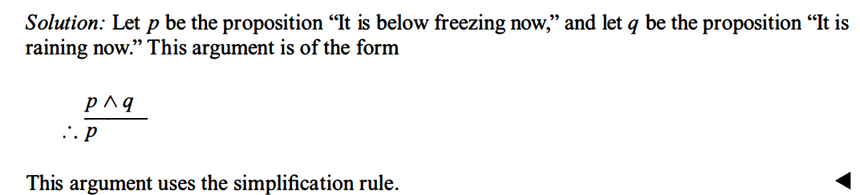
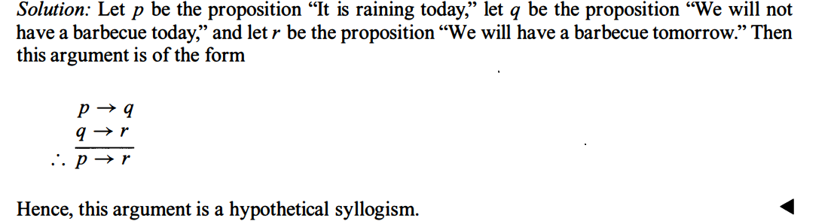
EXAMPLE 2: State which rule of inference is the basis of the following argument: "It is below freezing and raining now. Therefore, it is below freezing now."
EXAMPLE 3: State which rule of inference is used in the argument: If it rains today, then we will not have a barbecue today. If we do not have a barbecue today, then we will have a barbecue tomorrow. Therefore, if it rains today, then we will have a barbecue tomorrow

Slide 39
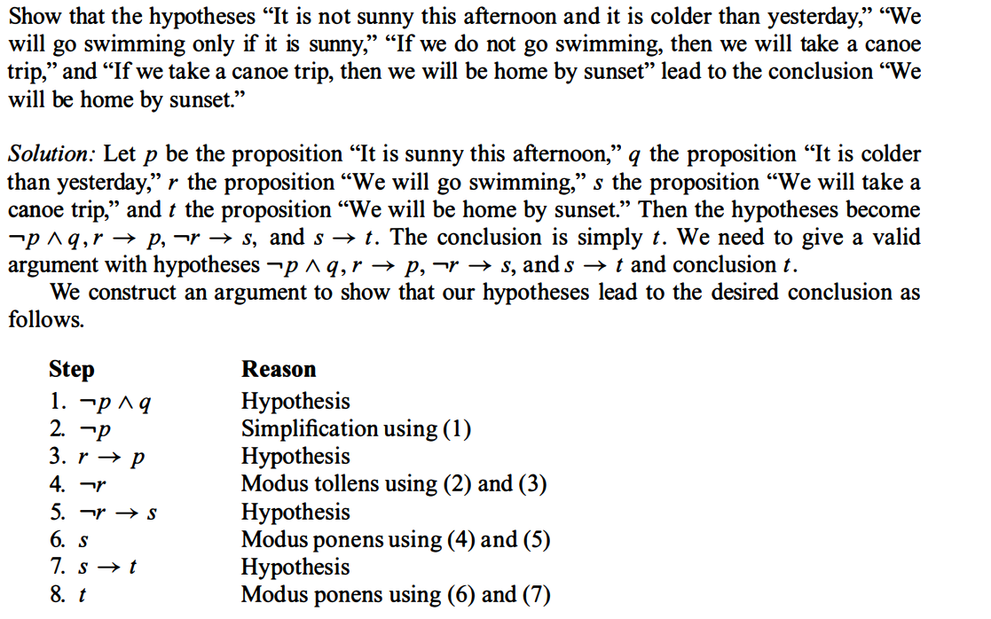

Slide 40
Real world example of how predicate calculus can be applied
Certainly, predicate calculus has various real-world applications in different domains. Here are examples of how it can be applied in database querying, formal verification, natural language processing, and mathematics and proofs:
**1. Database Querying:**
- **Example:** Consider a database of employees in a company with attributes like name, age, department, and salary. Predicate calculus can be applied to formulate queries such as "Find all employees in the HR department who earn more than $50,000." Here, predicates would represent conditions like "in HR department" and "earns more than $50,000."
**2. Formal Verification:**
- **Example:** In hardware and software engineering, formal verification involves checking whether a system or program meets specified requirements or behaves correctly. Predicate calculus can be used to define formal specifications and properties. For instance, in software, you might express properties like "the program always terminates" or "data integrity is maintained."
**3. Natural Language Processing (NLP):**
- **Example:** In NLP, predicate calculus can be used to parse and analyze the structure of sentences. For instance, consider the sentence "All cats are mammals." Predicate calculus can represent this as ∀x (Cat(x) → Mammal(x)), where Cat(x) and Mammal(x) are predicates indicating whether x is a cat or a mammal, respectively. This representation can be used for logical reasoning and information extraction.
**4. Mathematics and Proofs:**
- **Example:** In mathematics, predicate calculus is foundational for expressing and proving mathematical theorems. For instance, in number theory, one can use predicate calculus to represent statements like "For all integers x and y, if x is even and y is odd, then x + y is odd." This can be formalized as ∀x ∀y (Even(x) ∧ Odd(y) → Odd(x + y)), where Even(x) and Odd(y) are predicates indicating whether x is even and y is odd, respectively.
Predicate calculus provides a powerful framework for representing and reasoning about complex relationships, conditions, and properties in various real-world applications. Its formal and precise nature makes it particularly useful for handling structured data, logical analysis, and formal reasoning in different fields.

